Slide 1
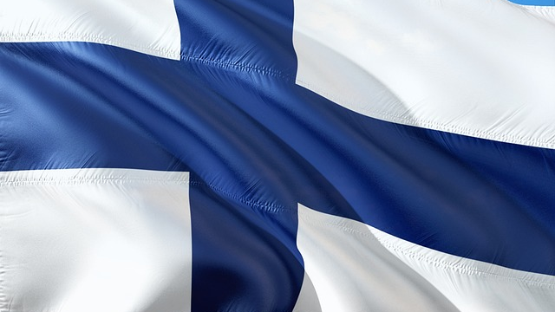
FINLAND
The Country
The school system
Alava`s school

Slide 2
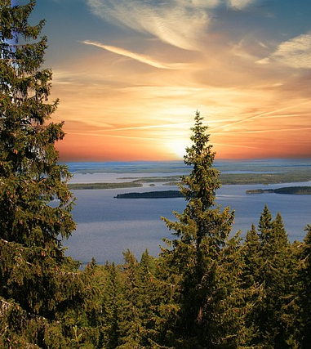
FINLAND
Population: 5,5 miljon
Head capital: Helsinki
Polity: President (Alexander Stubb)
Size: 338 462 km²
Official languages: finnish, swedish
Currency: euro
Borders with Sweden, Norway and Russia.

Slide 3
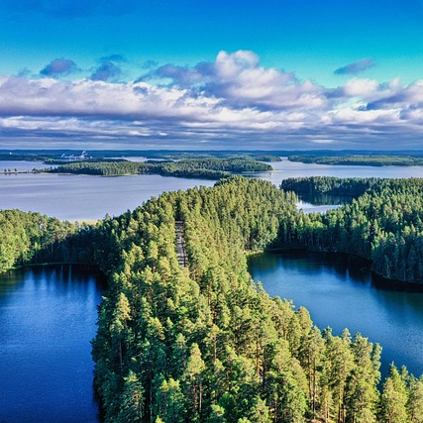
FUN FACTS
"Land of thousands of lakes and forrests" (187 888 lakes, about 75% of the hole area is forrest)
Cold winter (usually –5°C to –20°C, but it can be also -35°C!). Usually +15°C to +30 °C In the summer.
Home of Santa Clause
People like silence and their own space.
About 3,2 miljon saunas in the Finland.

Slide 4

Education in Finland
Education is highly valued
preschool (age 6), primary school (grades 1-6, school starts at age of 7) and secondary school (grades 7-9)
In basic education: 563 100 students
Provides all citizens with equal opportunities to recieve education.
Every student has the right to go to the nearest school.
Nationwide curriculum and equal possibility enter to upper secondary education
No charges
Free school lunch, school transport (if neaded), school books and teaching materials, school health services
Morning and afternoon activities (for special education students and first graders)

Slide 5
Some videos
https://peda.net/alavus/perusopetus/kirkkomannikonkoulu/erasmus2/erasmus/erasmus/suomi/se (Finland, from 6.50, 2min)
https://www.youtube.com/watch?v=j0LaAH97rcA (Kuopio, about 2min)

Slide 6
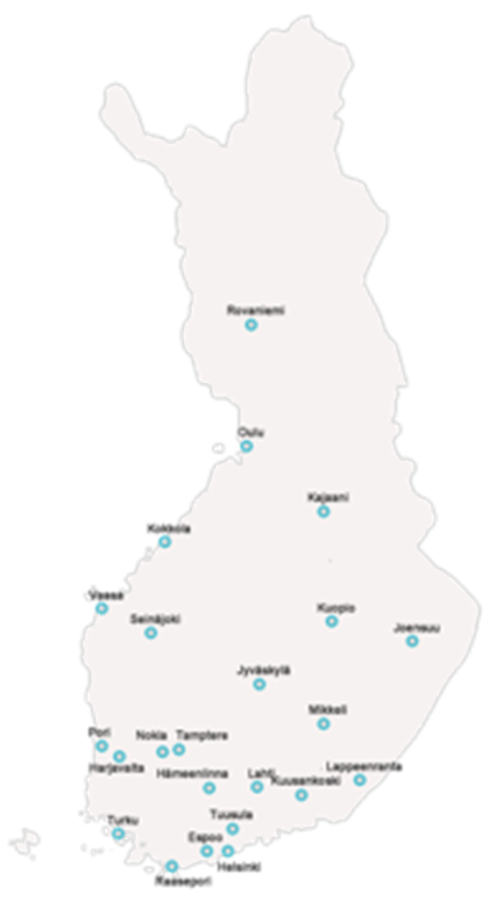
Hospital schools in Finland
Every student has right for schoolingeven though they are in hospital.
24 hospital schools in Finland
About 1000 students daily/ about 4000 students per year
We have also policlinical students which means that they don`t have hospital period going on.
We offer consultation mainstream schools when they need to plan support for student because of his or her health condition.

