Slide 1
FINNISH EDUCATION AND SPECIAL EDUCATION SUPPORT
consulting special education teachers
Marja Rissanen
Krista Tarkiainen 2025

Slide 2
Details….
In 2022:
In basic education: 563 100 students
Grades 1-6: 364 800 students
Grades 7-9: 188 500 students

Slide 3
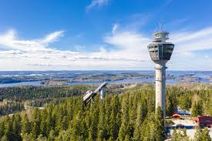
City of Kuopio
Schools:
Basic education 36
Special Schools 2
Vocational schools 7
General Upper Secondary Education 6
General Upper Secondary Education for Adults 1
Community School 1
Pupils:
Preschool Education 1133
Basic Education 11118

Slide 4
Education in Finland
Provides all citizens with equal opportunities to recieve education.
Every student has the right to go to the nearest school.
Also all disabled children go to school.

Slide 5
Vocabulary:
Daycare (age 0-5)
Preschool (age 6)
Primary school (grades 1-6, school starts at age of 7)
Secondary school (grades 7-9)

Slide 6
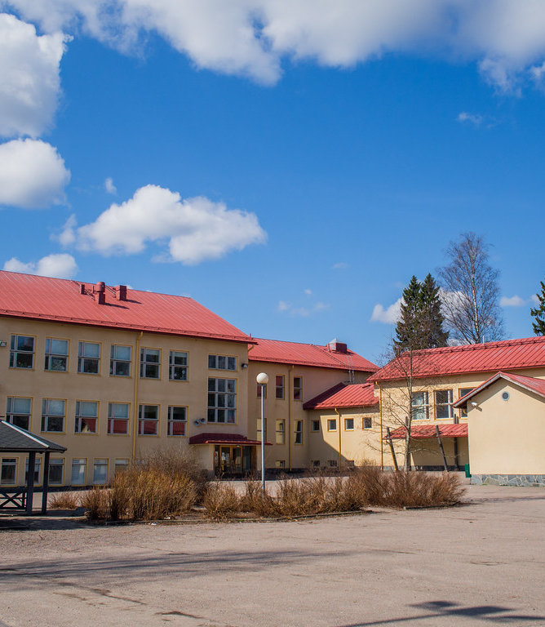
Basic education
Nationwide curriculum
No charges
Free school lunch, school transport (if neaded), school books and teaching materials, school health services
Morning and afternoon activities (for special education students and first graders)
Equal possibility enter to upper secondary education (upper secondary and vocational schools)
Tämä kuva, tekijä Tuntematon tekijä, käyttöoikeus: CC BY-NC-ND

Slide 7
Details…
Lessons are usually 45 min long and after that students go out for 15 minutes
They go out even in winter. If it is very cold (lower than -20*C, students can maybe stay inside)
All children learn to ski and skate at school
Handicrafts, music, domestic science and sports are important subjects

Slide 8
Teachers
All teachers have university level degrees
Pre-school education teachers have at least Bachelor’s degrees from University
Class teachers are Masters of Education and subject teachers have completed a Master’s degree in the subject they teach as well as pedagogical studies
Special needs education teachers are Masters of special education.

Slide 9
Staff in comprehencive schools
Headmaster
Debuty headmaster
Teachers
School assistants
Also: school nurse, school doctor, curator and psychologist

Slide 10
Special educational support
All schools have to provide support for student when needed
Main idea is that students get there support in the local school
Only few special schools in Finland

Slide 11
If student needs more intensive support:
Schools own special class
City’s intensive special class
Special school

Slide 12
Support structure (Basic education Act changes 1.8.2025):
Until 31.7.2025:
General, Intensive and Special support (three levels)
1.8.2025
Group-specific form of support
Pupil-specific form of support (two levels)

Slide 13
The idea of changing support system:
Clarify and harmonise the forms of learning support and support measures
Harmonise the continuum of support from pre-primary education to upper secondary education
Strengthen the focus of support on early and timely support
Less documents to write, more time to give support

Slide 14
How to support in the future?
Remedial teaching
Remedial teaching for teaching language
Special teachers support in the classroom
Teaching in special class temporarily or full time

Slide 15
How to support in the future?
Different kind of smaller groups
Modifying materials
Picture support teaching
Good Structure
Possibility to have more breaks
Support equipment
School assistans

Slide 16
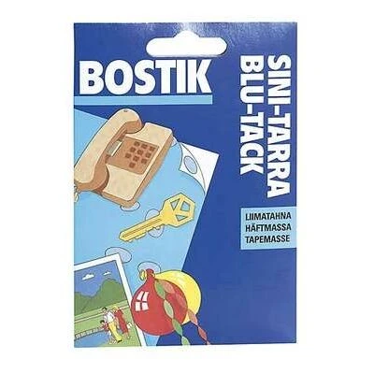
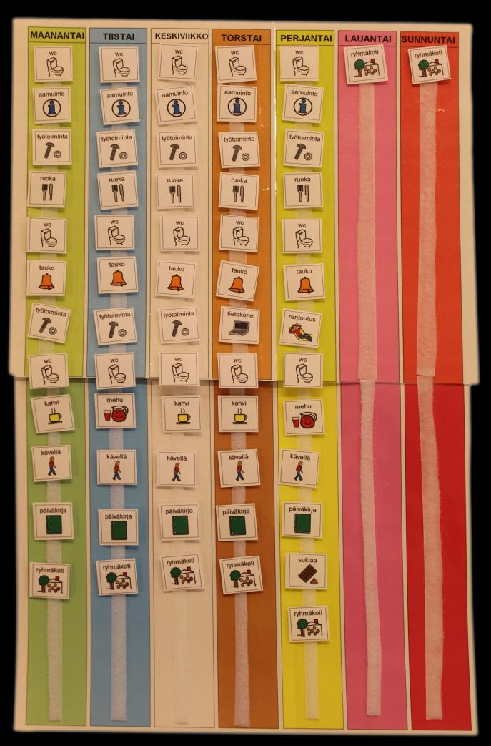
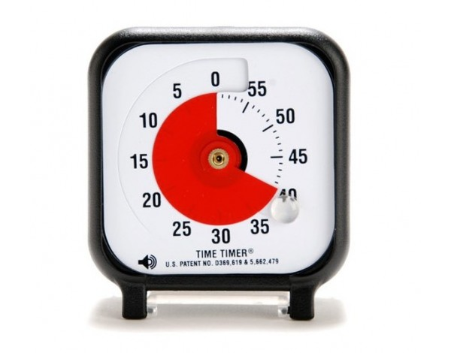
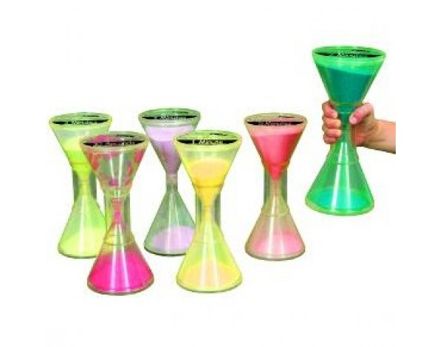
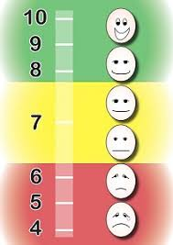
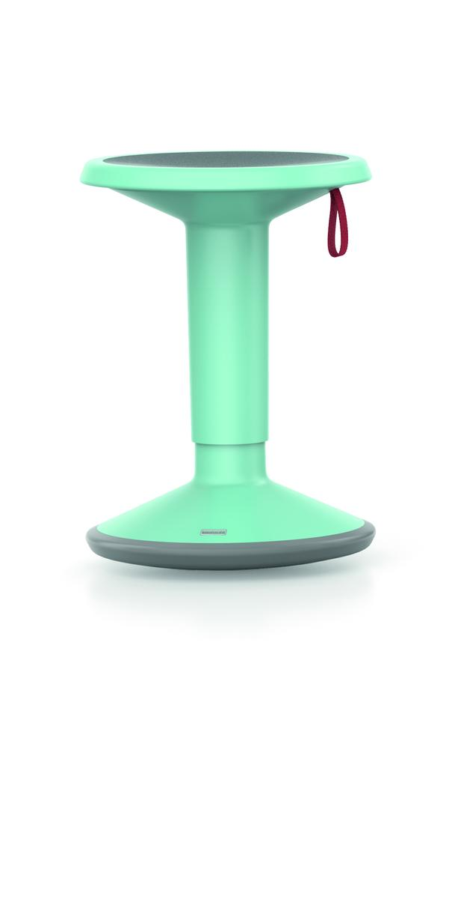
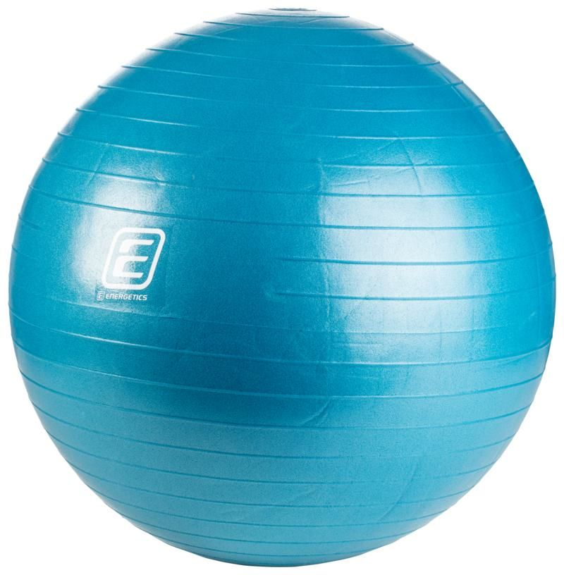
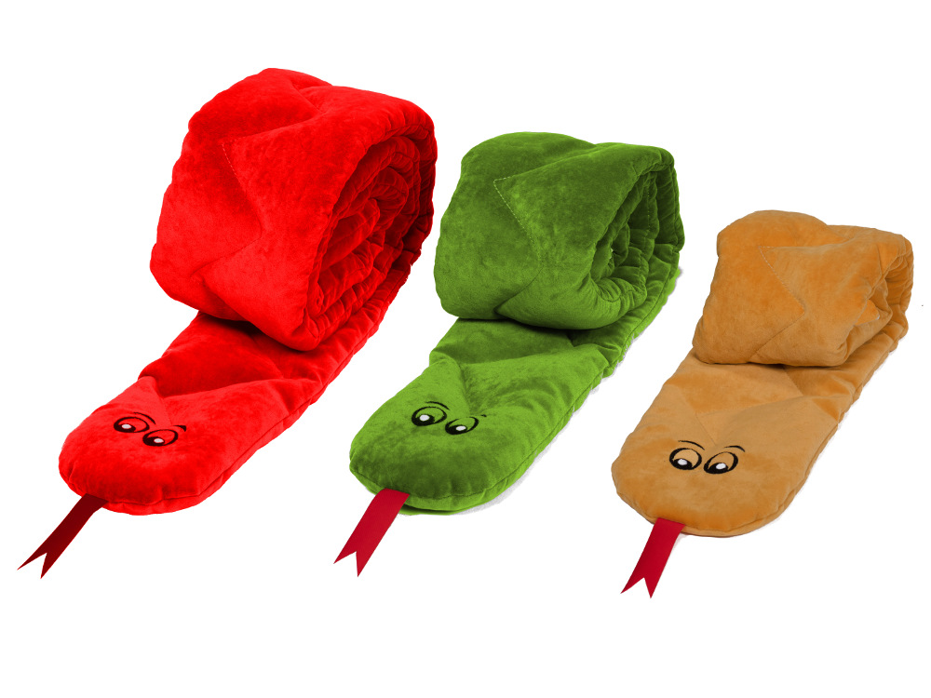
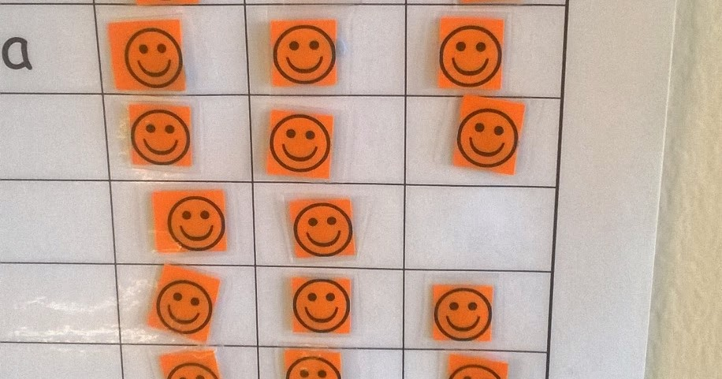

Slide 17
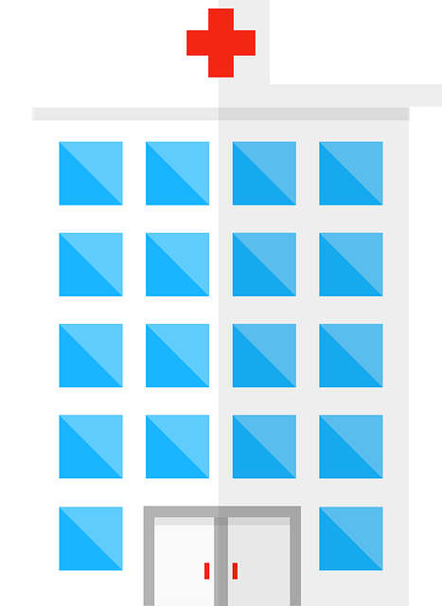
Alava hospital school

Slide 18
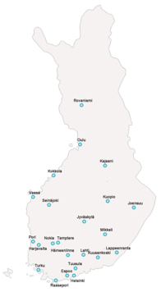
Hospital schools in Finland
Every student has a right for schooling even though they are in hospital.
24 schools in Finland
about 1000 students daily/ about 4000 students per year
We have also policlinical students which means that they don`t have hospital period going on.
We offer consultation for mainstreem schools, when they need to plan support for the student, bacause of his or her health conditions

Slide 19
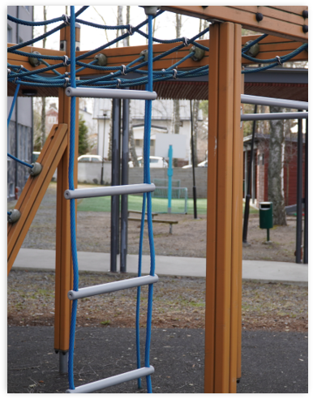
Alava school in Kuopio contains 5 units
Alava unit
Students ages from 6 to 14
Children's psychiatric helthcare
Laine unit
Students ages from 13-18
Youth psyciatric helthcare
Puijo unit
Studens ages from 6 to 18
Somatic ill students
Niuva unit
Underage students
Students who needs strong psyciatric healtcare
Puistola Unit
Students ages from 13 to 18
Students who are unable to attend their own school.

Slide 20
Staff
1 headmaster
12 special needs teachers
15 school assistants
3 consulting special needs teachers
2 school assistants who support students in their own schools
1 school secretary

Slide 21
Students health and learning ability are considered at hospital schools
Students have short or long term periods in our school. Periods can be from few days to several years.
Student's own school maintain always. For example they get their books and serficates from their own school.
Alava school collaborates strongly with student's own school. We help mainstrem schools to plan support when students go back.
We offer support and "normality" for students in their difficult times.

Slide 22
Thank you!

