Slide 1
School attendance problems and solutions
Erasmus 2023-2027

Slide 2
Every child or young person who has lots of absences from school are in danger to marginalize

Slide 3
Situation in Finland
In Finland there are about 4000 7.-9. graders, who have major problems in schooling. The amount has been growing lately.
The amount of boys and girls are similar.
These students have often learning problems and/or ADHD
(Vaativan erityisen tuen VIP-verkoston tilannekartoitus, Opetushallitus 2020:9)

Slide 4
School attendance problems in Kuopio
We have about 11 000 students in schools in Kuopio
Between 2019 and 2022 the amount of students who have over 200 hours absence from school grew most in grades 7-9, but also in grades 4-6
In 2021-2022 about 500 students had over 200 h abcense
School attendance problems have been growing in all grades
We use Commit to school stairs- model in Kuopio

Slide 5
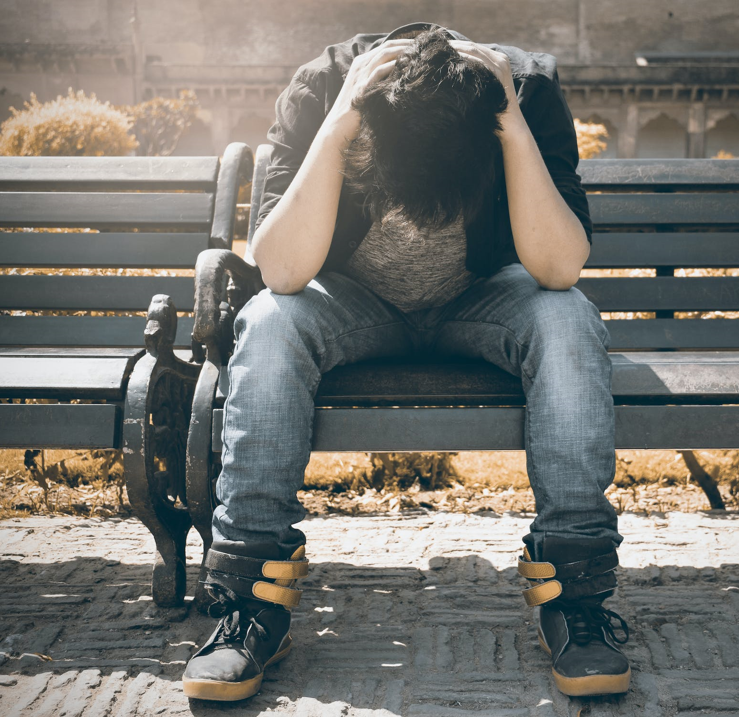
Often in background
Learning problems
Psychiatric challenges
Sense overloading
Bulling
Concern for parents, separation anxiety
Corona-period and distance learning
Intoxicants
Insecure and fear
Externality

Slide 6
Factors for drop out
Slowly increasing amount of being late and absences, difficult to notice them?
Slow reacting from school?
Homes easily permit absences?
Familys’ low and limitted resources?
Dropping out from daily rythm?
Increase of authism spectrum diagnoses?
Slow attendence to health care?
Dependence from smart devices?

Slide 7
To get the student back to school is common task

Slide 8
Useful methodes
Call active cooperation network soon as possible: home, school, social and family workers, healthcare, therapists etc.
Good school atmosphere, good teacher- student relationship
Activate and involve student + understand underlying reasons
Train staff for identifying the problem and interveneing ways
Students desensitization slowly back to school
If needed: Special teaching arrangements: shorten school day or school week, grade independent studies and individual syllabus

Slide 9
1. Stocktaking and planning
Consult and call the network
Discussion and finding reasons
2. Planning the targets
School welfare group
Commit the network
Involve student
3. Achievment and supports in practise
Implement the support
Persistence and tolerate the situation
4. Evaluation meeting
What was successful, what was not?
What next?
5. Repeat!
Long-term working
Cooperation between workers!

Slide 10
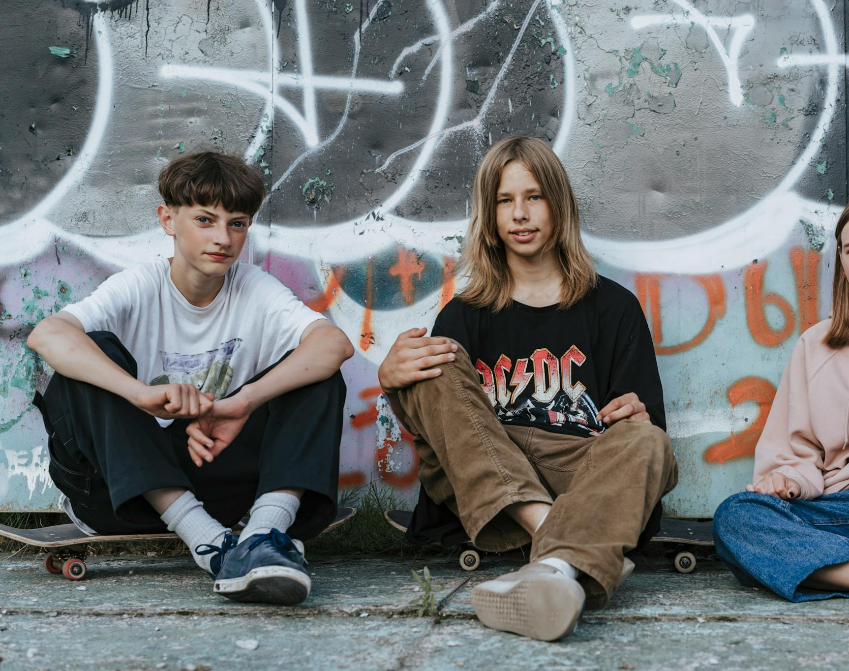
Clear plan and/or agreement which helps the student to realize what we expect, for example what time to come to school, how many hours a day etc.
Sometimes it is the small things that matter. Overloading!
Don’t make any pressure for the student about getting grades or getting to the next grade, presence in the classroom is enough!
Every time student comes to school: positive encouragement and reception
Often adults help is needed (leaving home, walking to school, some one of the staff receiving the student at the school yard)
Learning targets must be possible to reach, differentiate!

Slide 11
Some times it is needed to meet the student at school’s parking yard, at the hospital school or at home.
Often the student needs familiar and safe adult’s help to attend the school
Safe plan for the schoolday (what can I do if I get anxious, where can I get help, where can I go to calm down..)
Best way to get the student back to school is to deal with the background problems and solve them first
What longer the absence from school has been, that longer is the time for the process getting him/her back to school
Tomorrow is a new day and a new try ☺

Slide 12
Alava hospital school consultation
We have three consulting special needs teachers who can help and councel the schools to solve these problems.
We also have
- OTE class, which is intended for students who are unable to attend their own school
- age 13-18, 7-9 grades
- the class is not in any main streem school -> easy to attende
- main goal is the students’ success in going to school and progress in
their studies, as well as finding a further study path
- two school assistants who help students get back to school and they can be the safe adult for them for awhile

Slide 13
Thank you!

