Slide 1
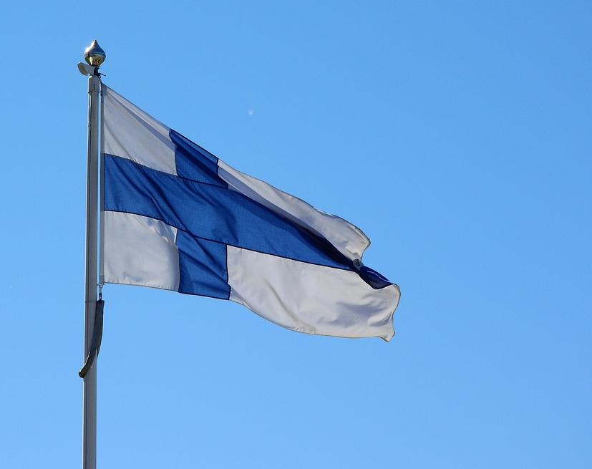
FINNISH EDUCATION
Krista Tarkiainen 17.2.2025

Slide 2
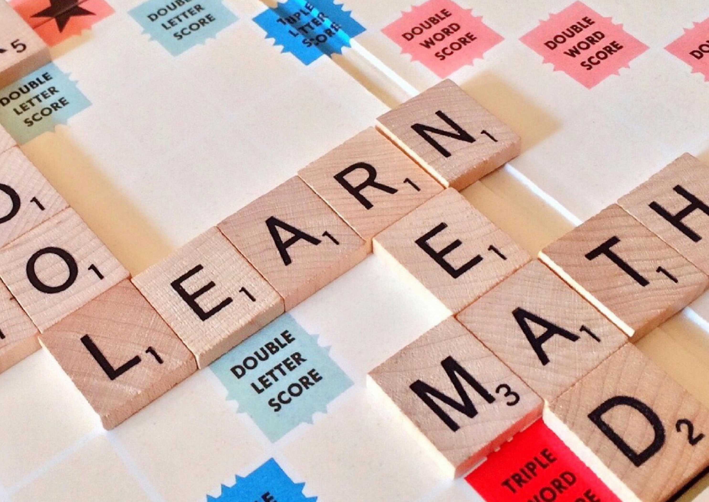
Education in Finland
Provides all citizens with equal opportunities to recieve education

Slide 3
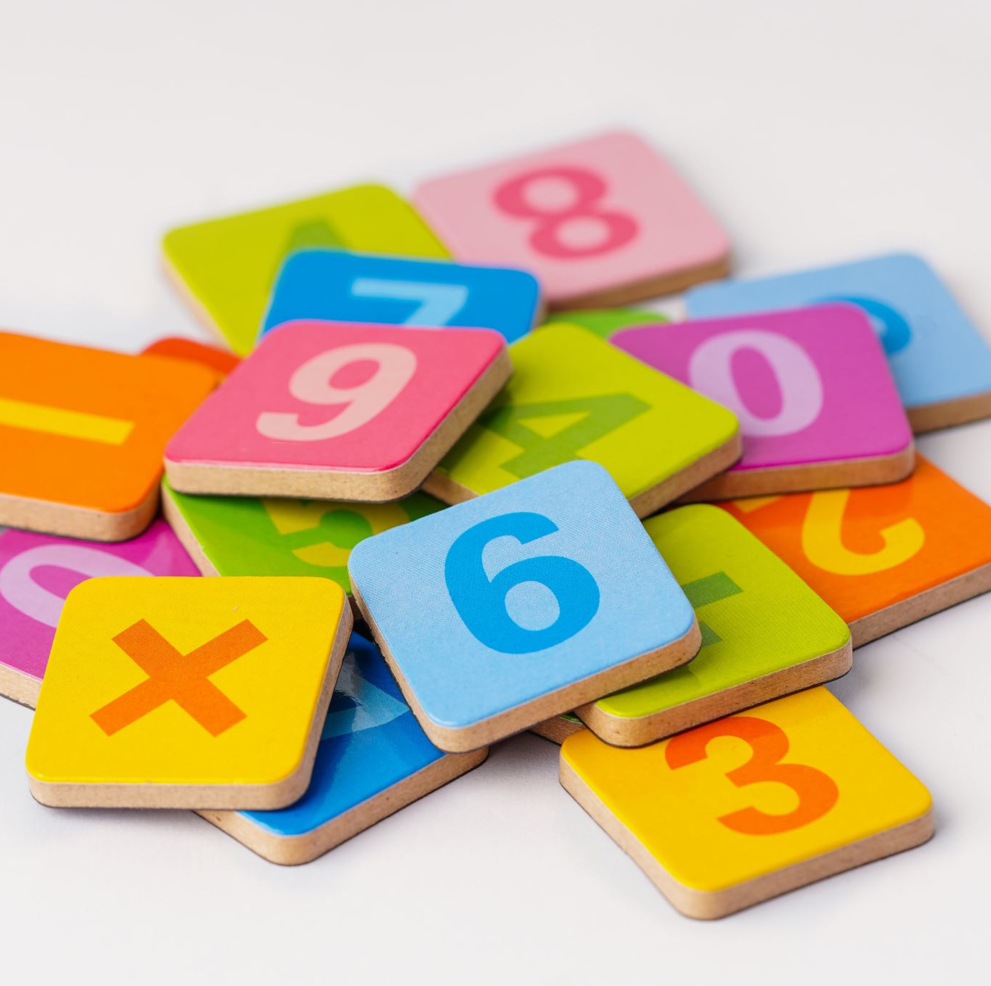
Vocabulary:
Basic education= comprehensive school which includes:
Primary school (grades 1-6)
Lower secondary school/ middle school (grades 7-9)

Slide 4
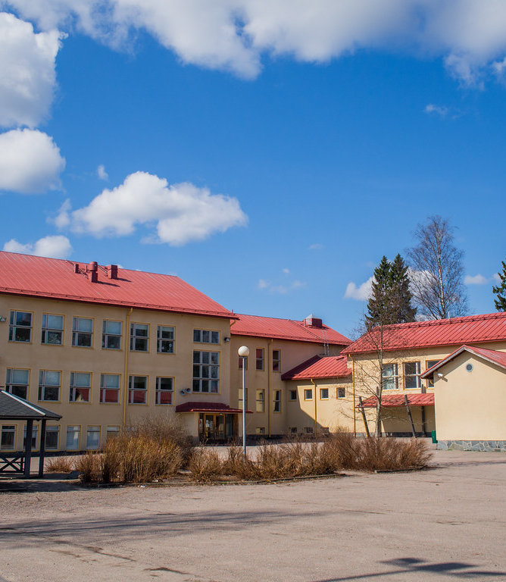
Basic education
A nine-year comprehensive curriculum for the whole age group
No charges
Free school lunch, school transport ( if more than 5 km to school), text books and teaching materials, school health services
One year pre-school education
Provides eligibility for all upper secondary education
Local authorities can provide morning( for special education) and afternoon activities (grade 1 and special education grades 1-9)
Tämä kuva, tekijä Tuntematon tekijä, käyttöoikeus: CC BY-NC-ND

Slide 5
Distribution of classroom hours (basic education):
Lesson per week: These are averages. Small differences between citys.
GRADE: | 1 | 2 | 3 | 4 | 5 | 6 | 7 | 8 | 9
SUBJECT:
Mother tongue | 7 | 7 | 5 | 5 | 4 | 4 | 3 | 3 | 4
A-language | 1 | 1 | 2 | 2 | 2 | 3 | 2 | 2 | 3
B-language |  |  |  |  |  | 2 | 1 | 1 | 2
Mathematics | 3 | 3 | 3 | 4 | 4 | 4 | 3 | 4 | 4
Environmental studies | 2 | 2 | 2 | 2 | 3 | 3
Biology/Geography |  |  |  |  |  |  | 2 | 2 | 3
Physics/Chemistry |  |  |  |  |  |  | 2 | 2 | 3
Health Education |  |  |  |  |  |  | 1 | 1 | 1
Religion/Ethics | 1 | 1 | 1 | 1 | 1 | 2 | 1 | 1 | 1
History/Social Studies |  |  |  |  | 2 | 1 | 2 | 2 | 3
Music | 1 | 1 | 1 | 1 | 1 | 1 | 1
Visual Art | 1 | 1 | 1 | 1 | 1 | 1 | 2
Craft | 1 | 1 | 2 | 2 | 2 | 2 | 3
Physical Education | 2 | 2 | 2 | 2 | 2 | 2 | 2 | 2 | 2
Home Economics |  |  |  |  |  |  | 3
Pupil counselling | 2
Elective Subjects | 9
Lesson per week | 19 | 19 | 23 | 23 | 24 | 24 | 30 | 30 | 30
Optional language |  |  |  | 2 | 2 | 2 | 2 | 2 | 2

Slide 6
Teachers
All teachers have university level degrees
Pre-school education teachers have atleast Bachelor’s degrees from University
Class teachers are Masters of Education and subject teachers have completed a Master’s degree in the subject they teach as well as pedagogical studies

Slide 7
Staff in comprehencive schools
Headmaster
Debuty headmaster
Teachers
School assistants
Also: school nurse, school doctor, curator and psychologist

Slide 8
After comprehensive school:
Upper secondary school
Vocational school

Slide 9
FEATURES OF THE UPPER SECONDARY SCHOOL
Admission requirement: completion of comprehensive school
Selection: previous study record
Progress in studies is individual
Syllabus planned for three years (2-4 years)
Students are usually 16-19 years
More than half of each age group complete upper secondary school

Slide 10
Matriculation exam
At least four tests:
Mother tongue
Three of these:
Swedish, Foreign language, Mathematics and one test in the General studies battery of tests (sciense and humanitys)
Candidates can also do as many optional tests they want.
The final checking of the tests is done by the Finnish Matriculation Examination Board.

Slide 11
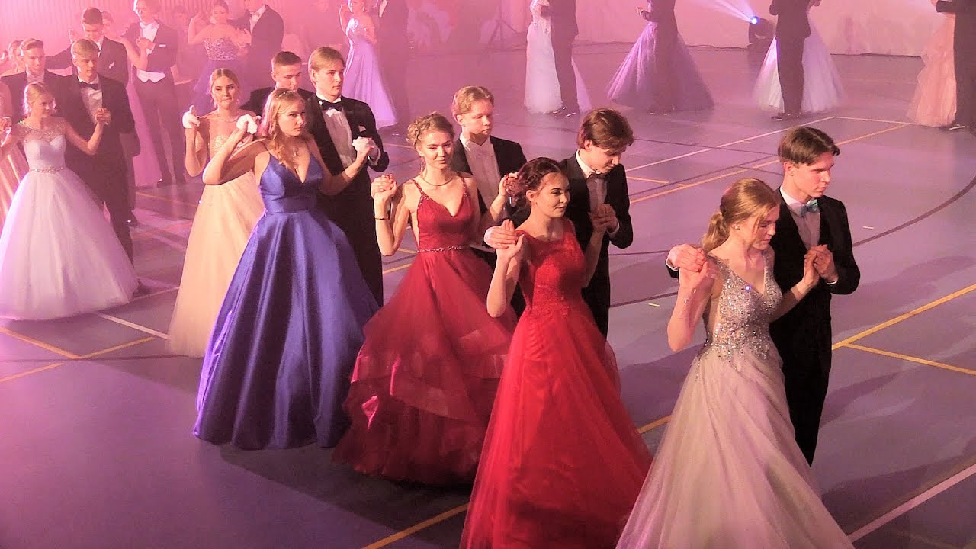
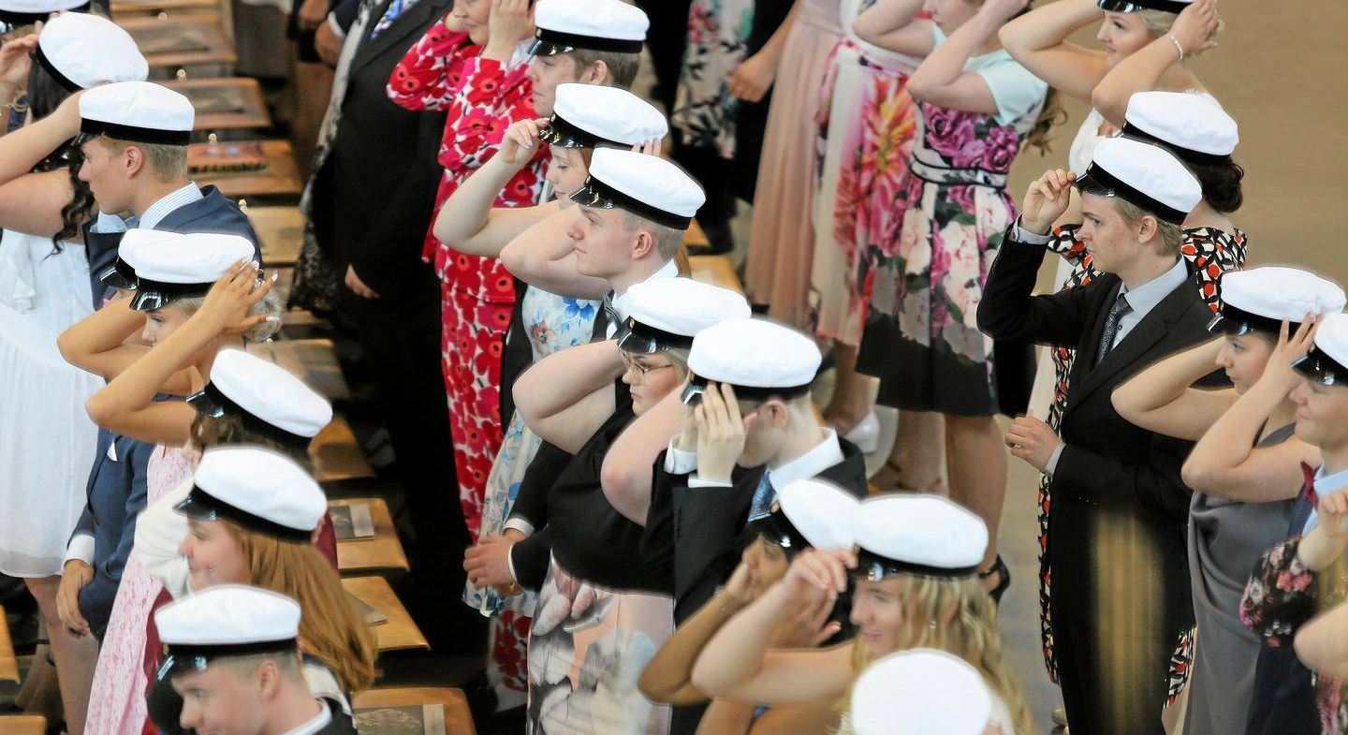
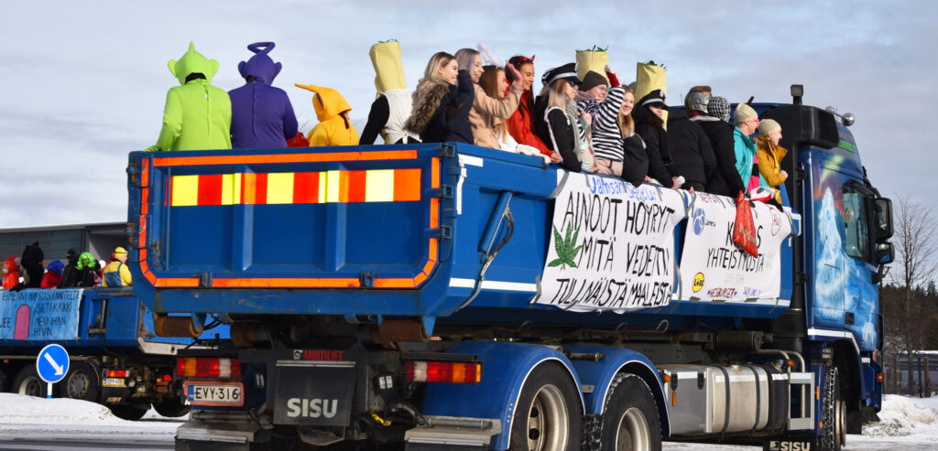

Slide 12
Vocational school
Many different fields of vocational qualifications
For example: technical field, commerce and administration, service sector, social and health care, natural resources and environmental fields, cultural and creative fields, information technology, security services, property services, marine and fisheries…

Slide 13
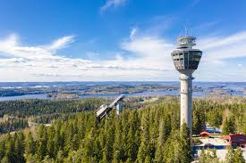
City of Kuopio
Schools:
Basic education 36
Special Schools 2
Vocational schools 7
General Upper Secondary Education 6
General Upper Secondary Education for Adults 1
Community School 1
Pupils:
Preschool Education 1133
Basic Education 11118

Slide 14
Basic ideas
Every pupil has the right to go to the nearest school
Most of the schools have one or two special classes
Special support pupils can also study in mainstreem classes

Slide 15
Special classes serving the entire city
Students with developmental language disorder
Two schools: Haapaniemi and Pyörö, eight classes, 64 student places
Students with intellectual disability
Two schools: Kalevala and Martti Ahtisaari, 12 classes (96 student places)
One totally special school Paloaho, four classes (24 student places)
Students with psychological and behavioral challenges
two schools: Snellman and Jynkkä, 6 classes (48 student places)
Teacher, 1 assistant and 8 student
Teacher, 4-5 assistents, 6 students
Teacher, 2-5 assistents, 8 students
Teacher two assistents and 6 students
Grades 1-6
Grades 1-9
Grades 1-6

Slide 16
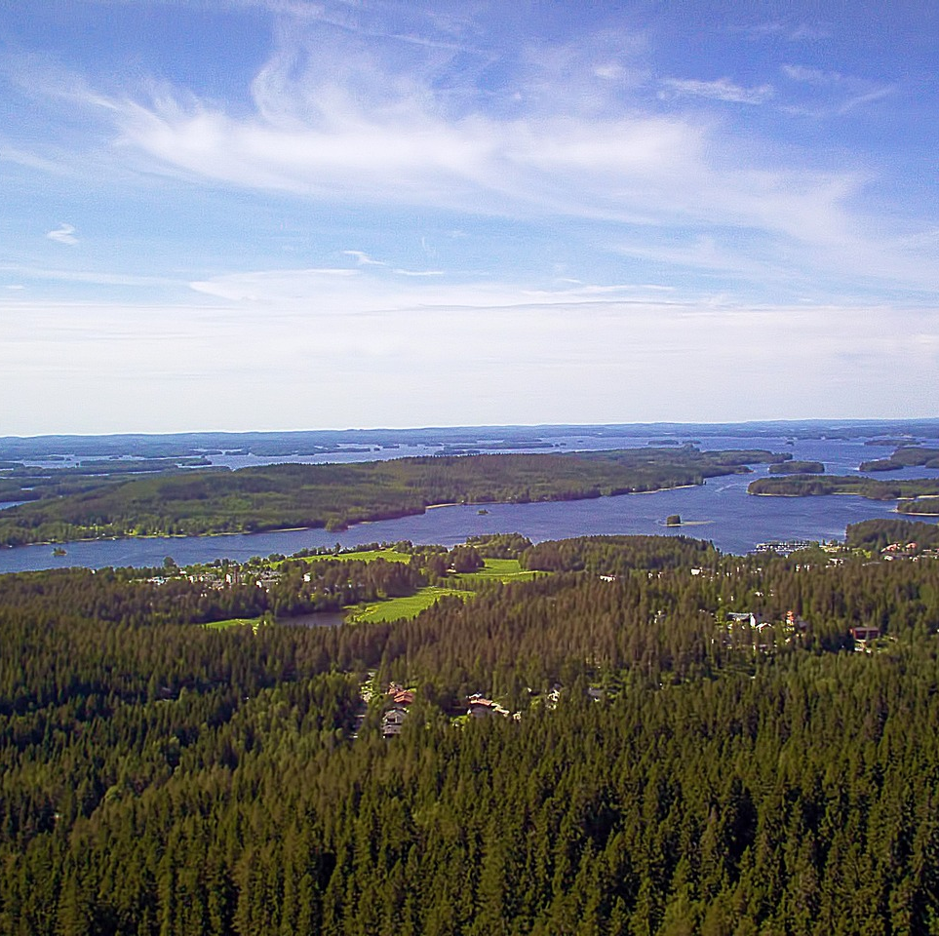
Schools of Kuopio
Schools are very different sizes
They can have several parallel classes or there can be grades 1-3 in same class
Some of the schools are even 78 km from the centre of Kuopio
Some of them are primary schools grades 1-6 or lower secondary schools 7-9 or they are comprehensive schools 1-9
Children go to pre school at age six and they start primary school when they are seven years old

Slide 17
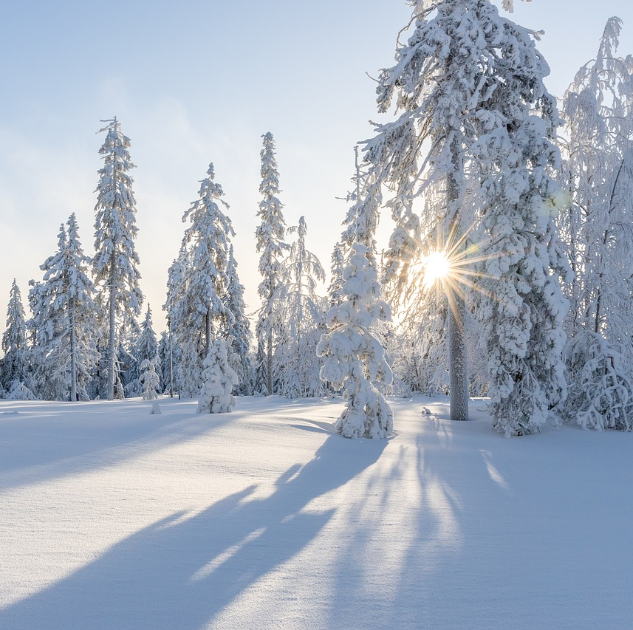
Details…
Lessons are usually 45 min long and after that students go out for 15 minutes
They go out even in winter. If it is very cold (lower than -20*C, students can maybe stay inside)
All children learn to ski and skate at school
Handicrafts are important subjects in school an also music

Slide 18
Thank you and welcome to Finland !

