Slide 1
Alava school
Erasmus
2023-2027

Slide 2
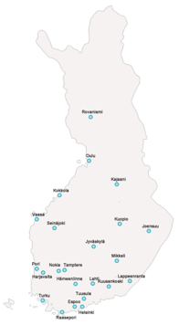
Hospital schools in Finland
Every student has a right for schooling even though they are in hospital.
There are 24 schools.
There are about 900 students.
We have also policlinical students which means that they don`t have hospital period going on.
Students health and learning ability are considered in hospital schools.

Slide 3
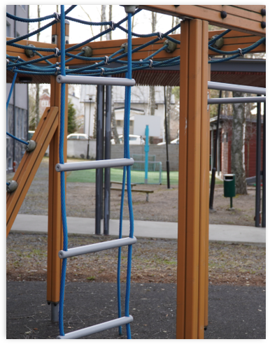
Alava school in Kuopio contains 5 units
Alava unit
Students ages from 6 to 14
Children's psychiatric helthcare
Laine unit
Students ages from 13-18
Youth psyciatric helthcare
Puijo unit
Studens ages from 6 to 18
Somatic ill students
Niuva unit
Underage students
Students who needs strong psyciatric healtcare
Puistola Unit
Students ages from 13 to 18
Students who are unable to attend their own school.

Slide 4
Staff
1 headmaster
12 special needs teachers
15 school assistants
3 consulting special needs teachers
2 school assistants who support students in their own schools
1 school secretary

Slide 5
Students have short or long term periods in our school. Periods can be from few days to several years.
Student's own school maintain always. For example they get their books and serficates from their own school.
Alava school collaborates strongly with student's own school. We help mainstrem schools to plan support when students go back.
We offer support and "normality" for students in their difficult times.

